Slide 1
Symmetry
Year 7
Mrs F
ALLPPT.com _ Free PowerPoint Templates, Diagrams and Charts

Slide 2
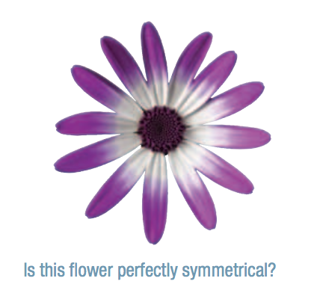
Symmetry
Introduction
The most familiar form of symmetry, called line symmetry,
is connected to the idea of reflection. A flower, for example,
might have one of more lines of reflection or mirror lines.
The flower might also have another form of symmetry called
rotational symmetry, which will also be looking at.

Slide 3
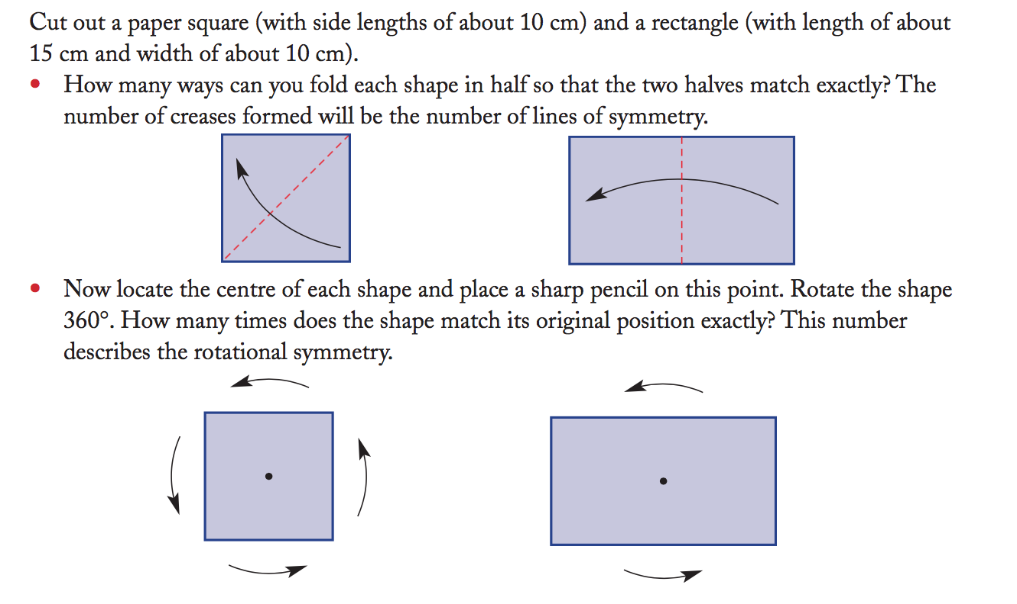
Opener

Slide 4
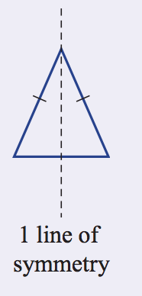
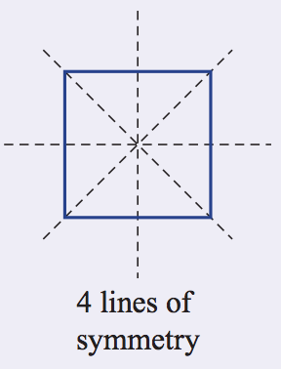
Symmetry
EQ – How can we describe Symmetry?
What is
Symmetry?
If the axis of reflection splits a shape into two identical pieces, then
that shape has reflection symmetry.
What is the line of Symmetry?
The axis of reflection is then called the “axis of symmetry”.
An axis or line of symmetry divides a shape into two equal parts.
It acts as a mirror line, with each half of the shape being a
reflection of the other.
The line (axis) along which a figure could be folded to produce identical
halves

Slide 5
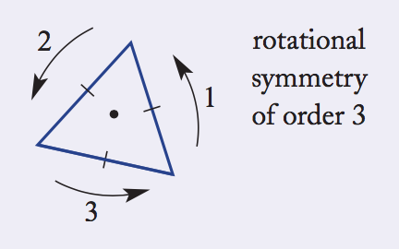
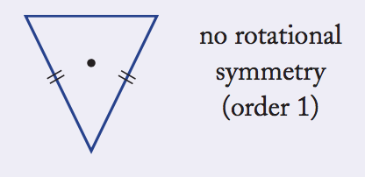
Symmetry
EQ – How can we describe Symmetry?
What is rotational
Symmetry?
Rotational symmetry When a figure rotated less than 360°
matches its original position
What is order of
rotational
Symmetry?
The order of rotational symmetry is the number of times a
shape matches its original position exactly during rotation of 360°.
Order of rotational symmetry The number of times a figure
matches its original position during rotation of 360°

Slide 6
Your turn
Continue -My Transformation Booklet

